Slide 1
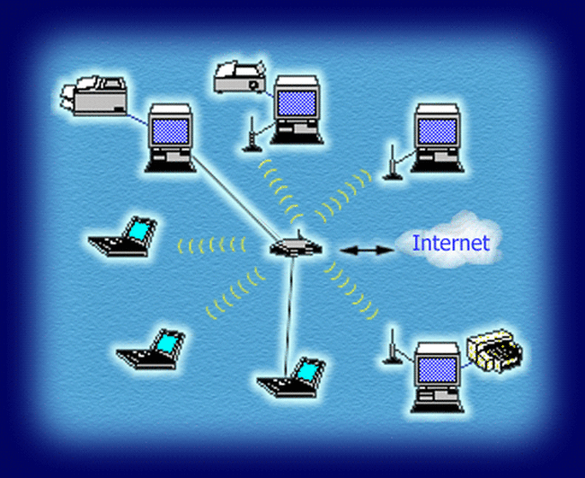
CEPCC408 : COMPUTER NETWORK
Chapter 2: Data Link Layer

Slide 2
Learning Objective
To use fundamentals of computer engineering to learn the various issues and the available solution of Data Link Layer and Medium access control layer.

Slide 3
Contents
2.1 Overview of DLL, Issues of DLL: Framing, Error Detection and Correction: Parity, CRC, Checksum, Hamming Code
2.2 Elementary Data Link protocols, Stop and Wait, Sliding Window (Go Back N, Selective Repeat)
2.3 Medium Access Control Sublayer Channel Allocation problem, Multiple access Protocol (Aloha, Carrier Sense Multiple Access (CSMA/CD)
Self-Learning Topics: HDLC protocol, CSMA/CA

Slide 4
Learning Outcomes
A learner will be able to:
A learner will be able to
LO2.1: Apply engineering fundamentals to solve channel allocation problem in Medium Access Control sublayer (P.I-1.3.1)
LO2.2: Apply computer engineering fundamentals to find various issues of DLL. (P.I.-1.4.1)
LO2.3: Compare various Elementary Data Link protocols based on functionalities. (P.I.-2.2.2)
LO2.4: Apply engineering mathematics to solve numerical problems based on Error Detection and Correction techniques. (P.I.-2.4.1)

Slide 5
CIA 2: class Test 2.1 to 2.4 +
Activity for self-learning by 02 Fast learners: HDLC protocol and CSMA/CA

Slide 6
LECTURE #8:
Overview of DLL, Issues of DLL: Framing

Slide 7
Functions of the data Link layer
Framing: Framing is a function of the data link layer. It provides a way for a sender to transmit a set of bits that are meaningful to the receiver. This can be accomplished by attaching special bit patterns to the beginning and end of the frame.
Physical addressing: After creating frames, Data link layer adds physical addresses (MAC address) of sender and/or receiver in the header of each frame.
Error control: Data link layer provides the mechanism of error control in which it detects and retransmits damaged or lost frames.
Flow Control: The data rate must be constant on both sides else the data may get corrupted thus , flow control coordinates that amount of data that can be sent before receiving acknowledgement.
Access control: When a single communication channel is shared by multiple devices, MAC sub-layer of data link layer helps to determine which device has control over the channel at a given time.
Frame Synchronization : When data frames are sent on the link, both machines must be synchronized in order to transfer to take place.

Slide 8
Design Issues of DLL
1. Services Provided to the Network Layer
The data link layer defines what kind of service it offers upward. Common service models include:
Unacknowledged connectionless service – frames are sent without acknowledgments (used when error rates are low).
Acknowledged connectionless service – each frame is individually acknowledged.
Acknowledged connection-oriented service – a reliable logical link is established with sequencing and acknowledgments.
The choice depends on reliability requirements and link characteristics.

Slide 9
2. Framing
Framing determines how a stream of bits is divided into discrete frames so that the receiver can identify frame boundaries. Common techniques include:
Character count
Byte stuffing
Bit stuffing
Physical layer coding violations
Correct framing ensures proper synchronization and interpretation of transmitted data.

Slide 10
3. Error Control
Transmission errors can occur due to noise and interference. The data link layer must:
Detect errors (using CRC, checksums, parity)
Correct errors (forward error correction) or
Recover from errors using retransmission mechanisms (ARQ protocols)
This ensures frames are delivered accurately and in order.

Slide 11
4. Flow Control
Flow control prevents a fast sender from overwhelming a slow receiver. Techniques such as:
Stop-and-Wait
Sliding Window protocols
are used to regulate the transmission rate based on receiver capability and buffer availability.
Flow control is a mechanism to control the flow of data when the receiver starts receiving more data than its capacity.
For example, the sender is sending the frame at the speed of 100 Mbps, and the receiver is capable of receiving the frame at the speed of 10 Mbps. So the receiver will send an acknowledgment to the sender to reduce the flow of data
When the sender receives the acknowledgment from the receiver, the sender will decrease the flow of data and starts transmitting data at the speed of 10 Mbps.
The receiving device should be able to send an acknowledgment when an increase in the flow of data.
To overcome the problem of flow control, each device has a block of memory known as a buffer. Buffer stores data until they are used for processing.

Slide 12
5. Medium Access Control (MAC) Coordination
When multiple nodes share a common medium (e.g., LANs, wireless networks), the data link layer must:
Decide who can transmit and when
Avoid or handle collisions
Ensure fair and efficient channel usage
This is handled by MAC protocols such as CSMA/CD, CSMA/CA, Token Passing, etc.

Slide 13
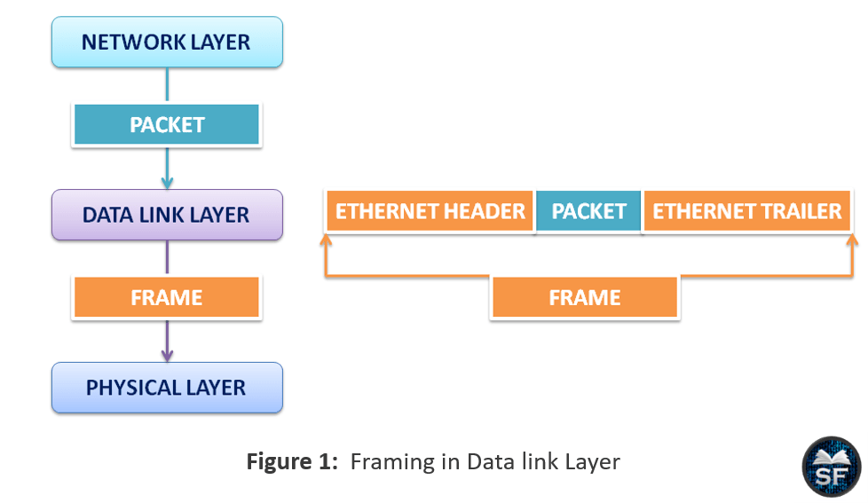
Framing
At physical layer, transmission of bits from source to destination takes place. Data link layer add these bits into frame.
Data link layer takes the packet from network layer and encapsulates them into frame.
If the frame size becomes too large, then the packet may be divided into small sized frames.
It sends each frame bit by bit on the hardware. At receiver’s end data link layer picks up signals from hardware and assembles them into frame.

Slide 14
Need for Framing
Framing is one of the responsibilities of the data link layer, which provides reliable communication between sender and receiver.
The frame contains the addresses of the sender and receiver. According to the destination address, the frame will be sent to the destination. When the destination receives the frame, it opens the frame and checks the sender’s address, and acknowledges to the sender that it has received the frame.
Basically, the data link layer receives packets from the network layer and converts the packets into frames.
The data link layer splits large frames into smaller frames to maintain the flow of data and reduce the chance of error between devices.

Slide 15
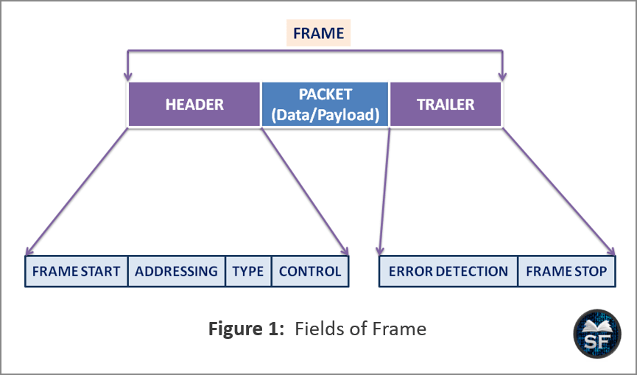
Structure of a frame

Slide 16
Header: The header contains the frame start, addressing, type, and control fields.
Frame start: We can identify the start of the frame by looking at the Frame Start field.
Addressing: It stores the address of the sender and receiver. According to the addressing field, the data link layer sends the frame from the sender to the receiver.
Type: The Type field is used to identify the network layer protocol that is used for header information.
Control: It provides a flow control mechanism. By using control fields, the network prioritizes packets that are important for communication.
Data: This is an IP packet received from the network layer. Packets are also known as payload or data at the data link layer. All protocols in the data link layer will be added to the frame’s data field.
Trailer: Error Detection and Frame Stop are the fields of the trailer. The data link layer information will be added to the trailer of the frame.
Error Detection: The trailer field of the frame contains an error detection method that is used to identify errors during communication.
Frame Stop: It is used to identify the end of the field.

Slide 17
Addressing
The data link layer uses physical addresses to transmit frames from sender to receiver. Generally, physical addresses are also known as MAC (Media Access Control) addresses.
MAC is a 48-bit number printed on the network interface card of the device. MAC address is an identifier of the device.
MAC address is divided into two parts that are Organization Unique Identifier and Unique Part. These two parts combine to form a MAC address that is unique to a device.
Physical addresses are used for data encapsulation and media access control.
The data link layer combines the MAC address of the sender and receiver in the frame with the IP address.
When the sender and receiver are on the same network, instead of using IP, the MAC addresses of the sender and receiver are used to transmit the frame.
Basically, when frames are transmitted from intermediary devices, the intermediary devices de-encapsulate the frames to understand the IP address and find the destination host.

Slide 18
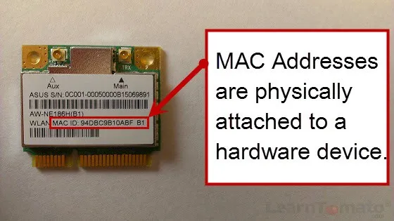
Type getmac and press Enter

Slide 19
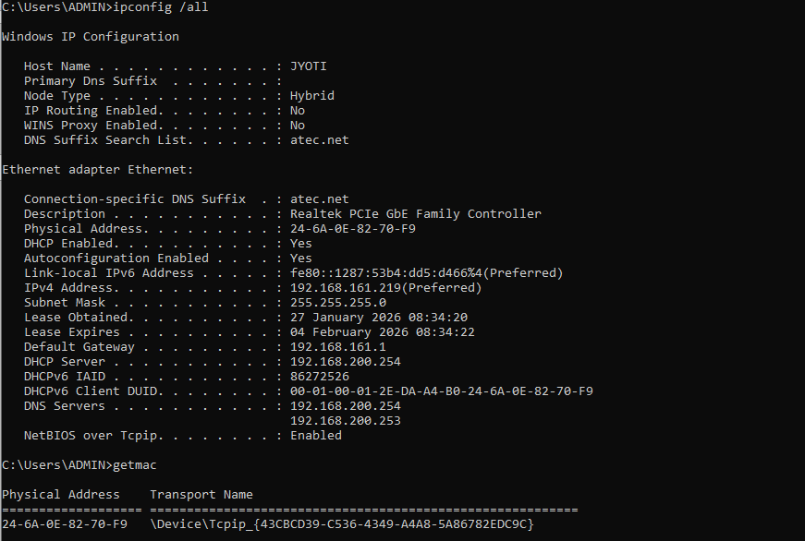

Slide 20
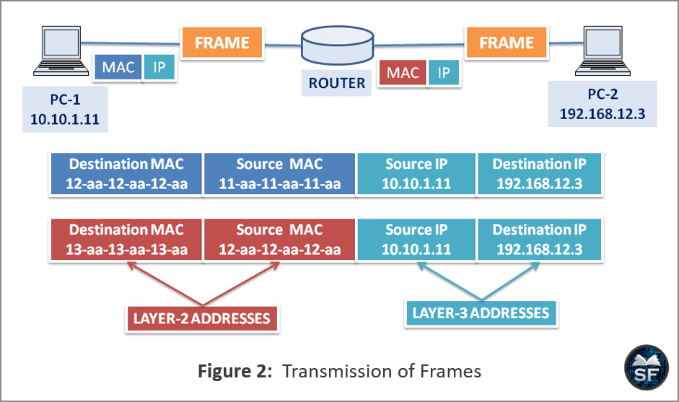

Slide 21
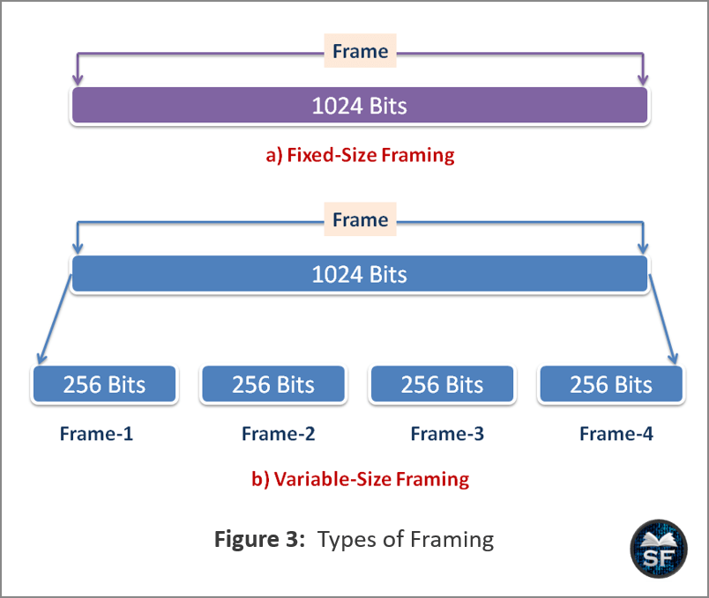
Types of framing
In fixed-size framing, a frame consists of 1024 bits, so if an error occurs, the receiver device has to check all 1024 bits, which is time-consuming for the receiver.
In variable-size framing, 1024 bits are divided into 4 frames of 256 bits each. Also, if there is an error in one of the frames, instead of checking all 1024 bits, the receiver will only check 256 bits of the frame that contains the error.

Slide 22
1. Fixed size – The frame is of fixed size and there is no need to provide boundaries to the frame, the length of the frame itself acts as a delimiter.
Drawback: It suffers from internal fragmentation if the data size is less than the frame size
Solution: Padding
2. Variable size – Here, the size of each frame to be transmitted may be different. So additional mechanism is required to mark the end of one frame and the beginning of the next frame.
Character-oriented / Byte oriented approach and
Bit-oriented approach

Slide 23
Challenges in Framing –
Identification of start of the frame:
When a frame is transmitted, every station must be able to detect it. Station detects frames by looking out for a special sequence of bits that marks the beginning of the frame i.e. SFD (Starting Frame Delimiter).
How does the station detect a frame:
Every station listens to link for SFD pattern through a sequential circuit. If SFD is detected, sequential circuit alerts station. Station checks destination address to accept or reject frame.
Detecting end of frame: When to stop reading the frame.

Slide 24
Definition and Need
Framing is the process of dividing a continuous bit stream from the physical layer into manageable units called frames, so the receiver can recognize the start and end of each data unit.
Why framing is needed?
Identifies frame boundaries
Ensures synchronization between sender and receiver
Enables error detection and flow control

Slide 25
Methods of Framing
Byte Count
Flag Bytes with Byte Stuffing
Flag Bits with Bit Stuffing
Physical Layer Coding Violations.

Slide 26
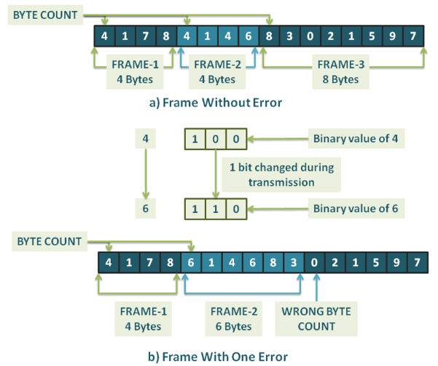
Types of Framing
16-byte message is divided into three frames. size of frame-1, frame-2, and frame-3 are 4, 4, and 8 bytes.
In frame-1, the value of byte count is 4, indicating that frame-1 contains 4 bytes. Similarly, frame-2 and frame-3 have byte count values 4 and 8, respectively, which describe the size of the frame.
But the problem here is that the bytes of the message can get flipped during transmission, which can cause an error. In Figure-b, the byte count of 4 becomes 6 due to one-bit reversal, so the receiver will be unable to detect the correct start of the frame.
Furthermore, sending an acknowledgment to the sender will also not work, as the receiver will not know how many bytes to skip to initiate retransmission. Therefore the byte count method is rarely used.

Slide 27
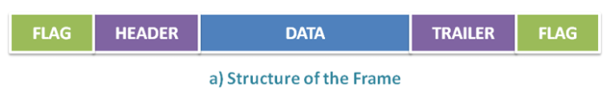
Flag Bytes with Byte Stuffing
This method uses a flag byte to indicate the start and end of the frame.
Two flags are used in the frame. The start flag describes the start of the frame, and the end flag describes the end of the current frame and the start of the next frame.
If the receiver loses synchronization between communications, it can know the current frame by looking at the two flags.
Drawback: If the flag bytes are 8 bytes (111111111) and the flag bytes are also in the data, an interrupt will occur in the frame.

Slide 28
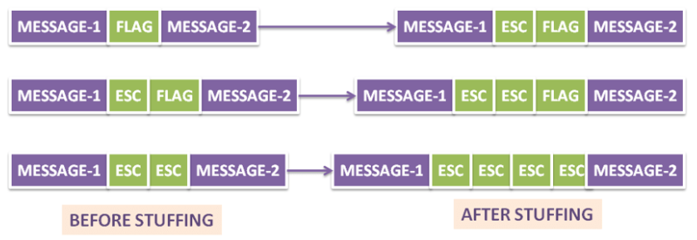
To solve this problem, we can add an escape byte (ESC) before the flag bytes.
When the data link layer receives the frame, it removes the ESC bytes from the frame and sends them to the network layer, this is known as byte stuffing.
Also, if the data contains ESC, we will add another ESC byte to prevent interference, as you can see some examples of byte stuffing

Slide 29
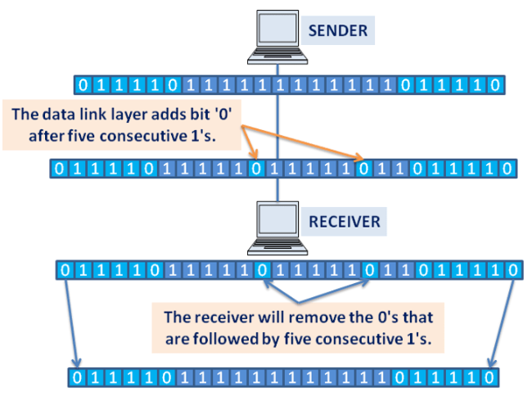
Flag Bytes with Bit Stuffing
In this method, framing is done with bits instead of bytes. The flag byte starts and ends with a special sequence of bits which is 01111110 in a frame. A well-known example of this method is USB (Universal Serial Bus). The physical layer maintains the synchronization of bits using this method.

Slide 30
When there are five consecutive 1’s in the data of the sender’s data link layer, then the data link layer automatically appends the bit ‘0’ after five consecutive 1’s.
The sender is sending a stream of bits to the receiver. In the middle of the communication, the data link layer will add a bit ‘0’ after five consecutive 1’s to the message.
When the receiver will receive the stream of bits, it sees the 0 bit followed by five consecutive 1’s, so it will remove the bit ‘0’ automatically.
A receiver can clearly identify the start and end of the frame using the bit stuffing method.

Slide 31
Physical Layer Coding Violations
Physical Layer Coding Violations
In this method, the message is encoded by the encoding method in such a way that both the sender and receiver can recognize it.
This method provides some reserved signals that indicate the start and end of the frame. We are using “coding violation” to delimit the frame of the data link layer.
A reserved signal is applied to the original data sent by the sender so that there is no problem on the receiver side to identify the data.
High-High (11) and Low-Low (00) are error codes used as escapes to differentiate data link layer frames.

Slide 32
LECTURE #9:
Error Detection and Correction: Parity, CRC, Checksum, Hamming Code

Slide 33
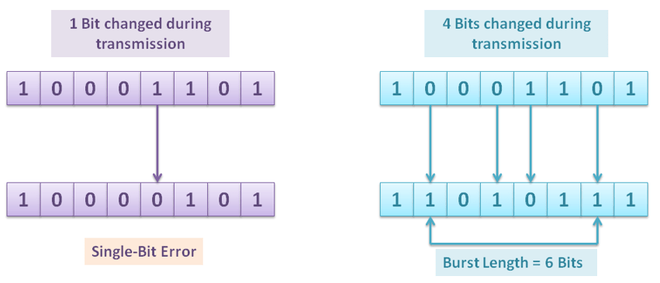
Types of Errors
Single-bit error: In a single-bit error, interference causes one bit of the message to change. For example, 0 to 1, or 1 to 0.
Burst error: In a burst error, two or more bits of the message are changed during transmission. Also, in a burst error, the change of bits doesn’t need to be sequential. We can measure burst length by measuring from the first corrupted bit to the last corrupted bit, some bits in between may not be corrupted.

Slide 34
Parity Check
Simplest error detection technique
Adds an extra bit (parity bit) to the data
Parity bit is set to make the total number of 1s either even or odd
Types
Even Parity: Total number of 1s is even
Odd Parity: Total number of 1s is odd
Features: Detects single-bit errors, Cannot detect even number of bit errors
Cannot correct errors

Slide 35
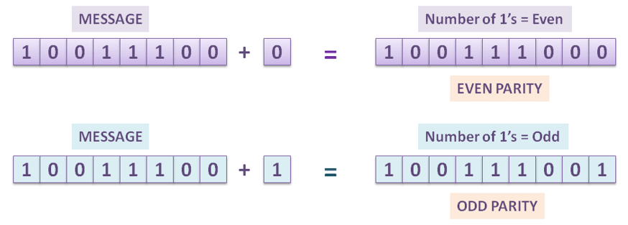
the sender is transmitting 10011100 and, bit 0 is added to it, now 100111000 has an even number of 1’s so that it is even parity. If 1 is added to 10011100, it will make the odd parity message 100111001.

Slide 36
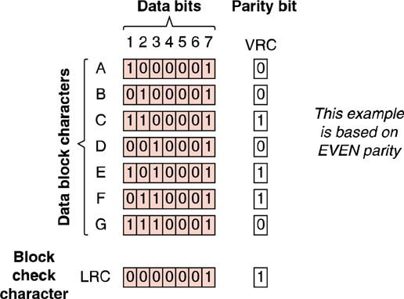
Block Parity Check
Block parity check in computer networks adds redundant bits (parity bits) to data blocks for error detection, ensuring the total count of '1's is consistently even (even parity) or odd (odd parity). 2 Dimensions

Slide 37
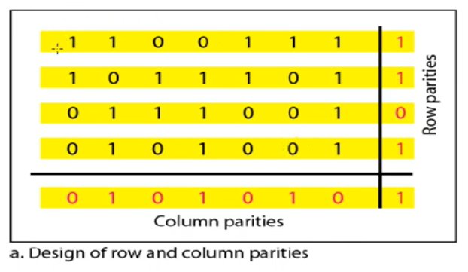
2-d parity check

Slide 38
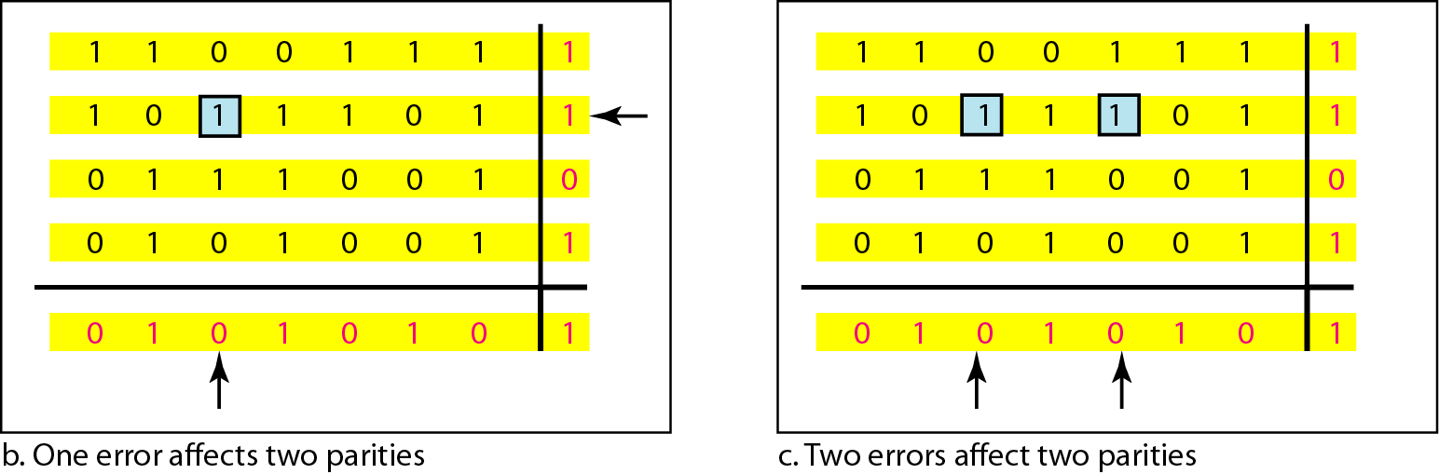
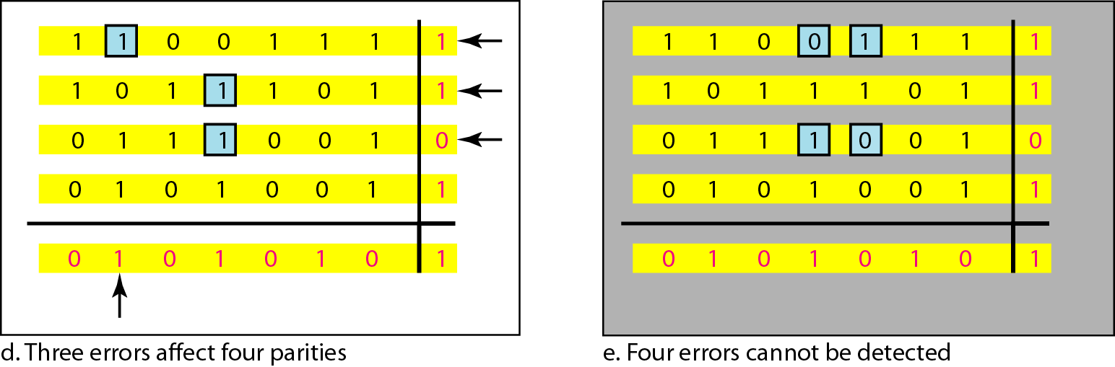

Slide 39
Checksum
Checksum works by summing all data segments using 1’s complement arithmetic, taking the complement of the result, appending it to the data, and verifying at the receiver by checking if the final complemented sum (including checksum) equals zero.
This method uses a Checksum Generator on the sender side.
A Checksum Checker is used on the receiver side.
The checksum is a unique number generated from the data to verify its integrity.
If the two checksums match, the data is likely error-free.

Slide 40
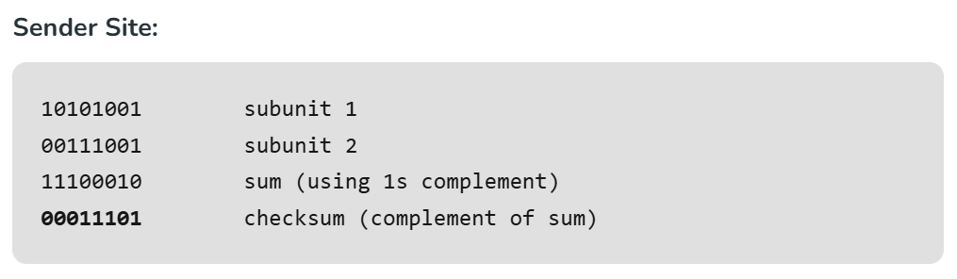
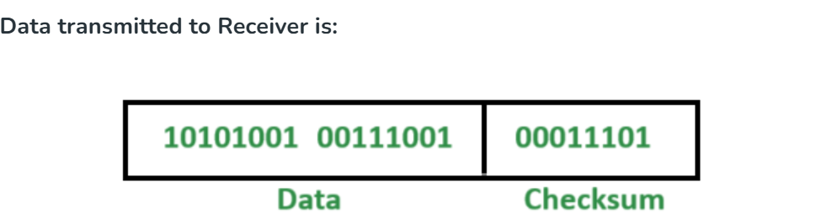
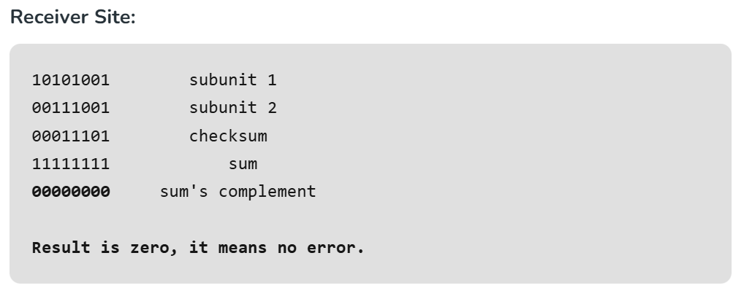
Example

Slide 41
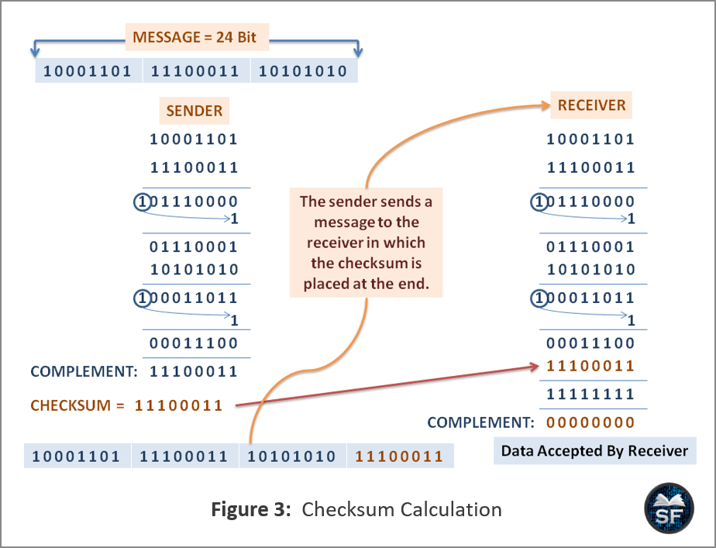

Slide 42
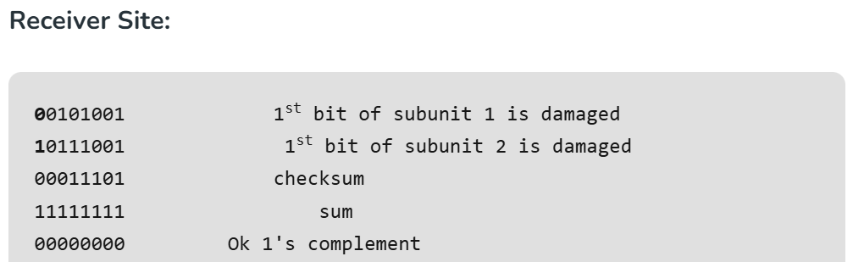
Drawback
Example 2 - If the data transmitted along with checksum is 10101001 00111001 00011101. But the data received at destination is 00101001 10111001 00011101.
Although data is corrupted, the error is undetected. Because the changes in data 1 and data 2 offset each other, resulting in the same overall sum. This is a limitation of simple checksum – it cannot detect all types of errors, especially when multiple errors cancel each other out.

Slide 43
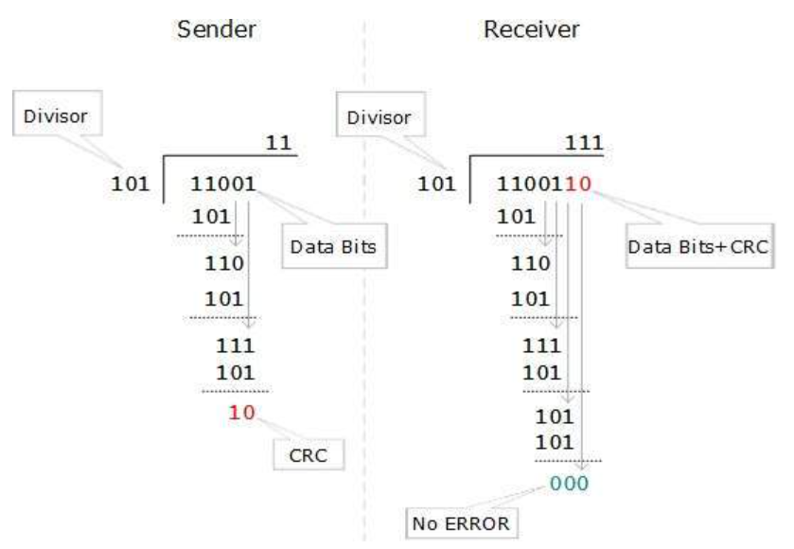
Cyclic Redundancy Check(CRC)
CRC is a different approach to detect if the received frame contains valid data. This technique involves binary division of the data bits being sent. The divisor is generated using polynomials. The sender performs a division operation on the bits being sent and calculates the remainder. Before sending the actual bits, the sender adds the remainder at the end of the actual bits. Actual data bits plus the remainder is called a codeword. The sender transmits data bits as codewords.

Slide 44
Cyclic Redundancy Check(CRC)
The steps used in CRC for error detection:
In CRC technique, a string of n 0s is appended to the data unit, and this n number is less than the number of bits in a predetermined number, known as divisor which is n+1 bits.
Secondly, the newly extended data is divided by a divisor using a process is known as binary division. The remainder generated from this division is known as CRC remainder.
Thirdly, the CRC remainder replaces the appended 0s at the end of the original data. This newly generated unit is sent to the receiver.
The receiver receives the data followed by the CRC remainder. The receiver will treat this whole unit as a single unit, and it is divided by the same divisor that was used to find the CRC remainder.
If the resultant of this division is zero which means that it has no error, and the data is accepted.
If the resultant of this division is not zero which means that the data consists of an error. Therefore, the data is discarded.

Slide 45
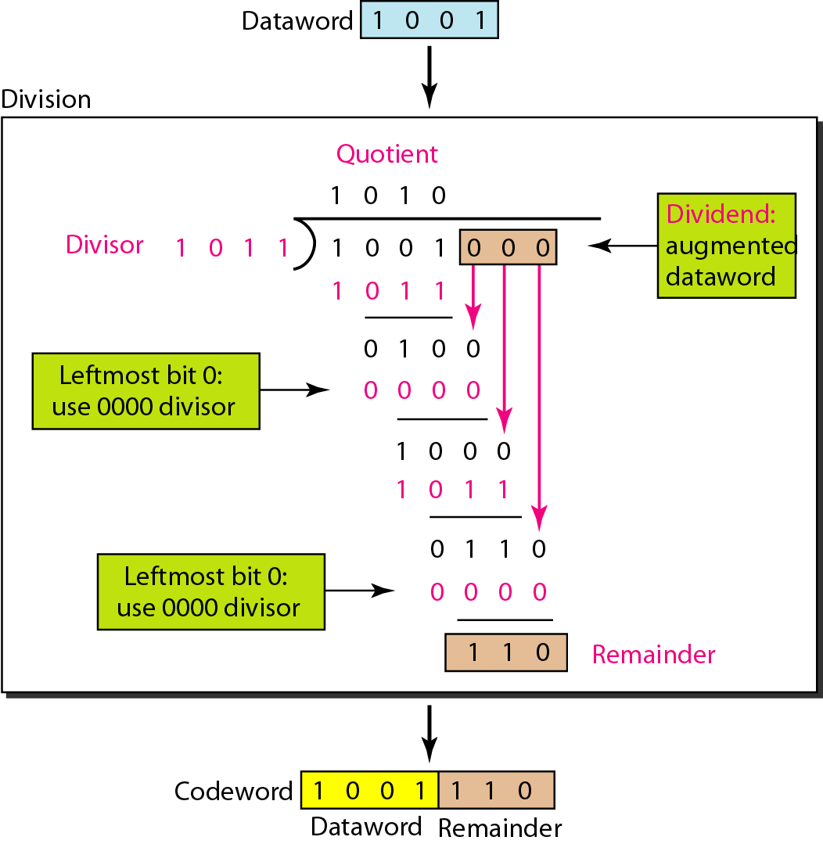
A CRC generator uses a binary division. Firstly, 3 zeroes are appended at the end of the data as the length of the divisor is 4 and the length of the string 0s to be appended is always one less than the length of the divisor.
Now, the string becomes 1001000, and the resultant string is divided by the divisor 1011.
The remainder generated from the binary division is known as CRC remainder. The generated value of the CRC remainder is 110.
CRC remainder replaces the appended string of 0s at the end of the data unit, and the final string would be 1001110 which is sent across the network.
CRC

Slide 46
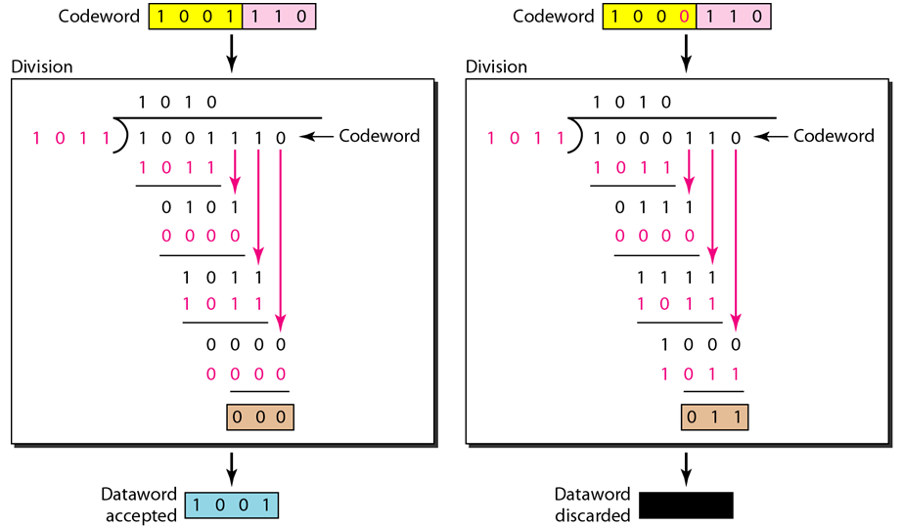
The functionality of the CRC checker is similar to the CRC generator.
When the string 1001110 is received at the receiving end, then CRC checker performs the binary division.
A string is divided by the same divisor, i.e., 1011.
In this case, CRC checker generates the remainder of zero. Therefore, the data is accepted

Slide 47
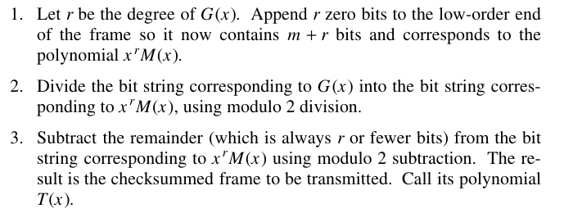
When the polynomial code method is employed, the sender and receiver must agree upon a generator polynomial, G(x), in advance. Both the high- and low order bits of the generator must be 1. To compute the CRC for some frame with m bits corresponding to the polynomial M(x), the frame must be longer than the generator polynomial. The idea is to append a CRC to the end of the frame in such a way that the polynomial represented by the checksummed frame is divisi ble by G(x). When the receiver gets the checksummed frame, it tries dividing it by G(x). If there is a remainder, there has been a transmission error.

Slide 48
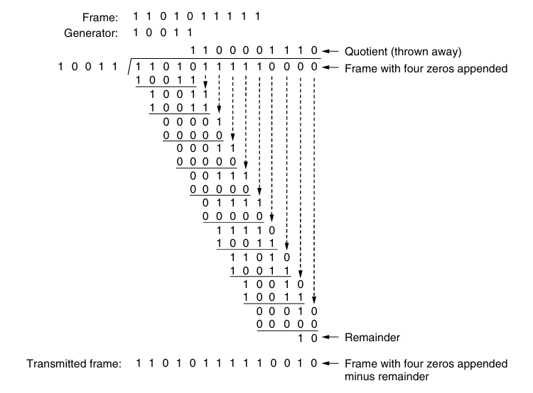
Cyclic Redundancy Check(CRC)

Slide 49
Hamming code
the message has m bits size and r bits of a check or redundant bits are added, and the sum of message ‘m’ bits and redundant “r” bits is known as a block. The sender creates the block on his behalf using Hamming or Binary Convolution method and sends it to the receiver. The receiver will use the error correction methods on the message to correct the error.
r₁ is the parity bit for all data bits in positions whose binary representation includes a 1 in the least significant position excluding 1 (3, 5, 7, 9, 11 and so on)
r₂ is the parity bit for all data bits in positions whose binary representation includes a 1 in the position 2 from right except 2 (3, 6, 7, 10, 11 and so on)
r₃ is the parity bit for all data bits in positions whose binary representation includes a 1 in the position 3 from right except 4 (5-7, 12-15, 20-23 and so on)
The position of the bits changed in the block during transmission is called the Hamming distance.

Slide 50
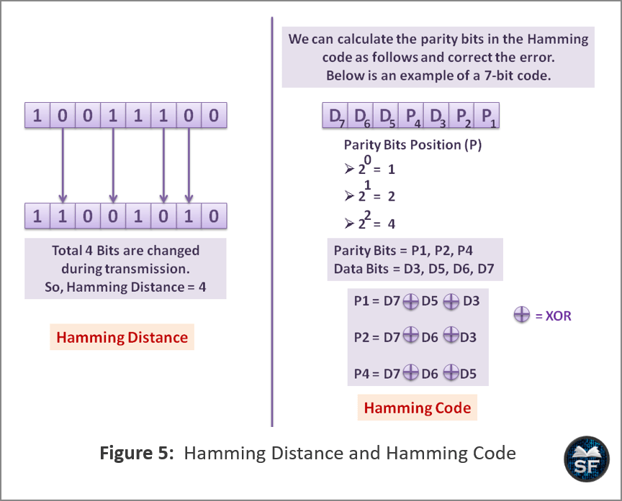

Slide 51
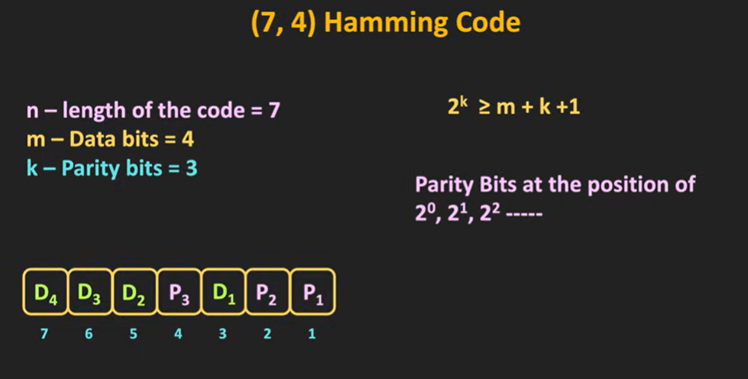
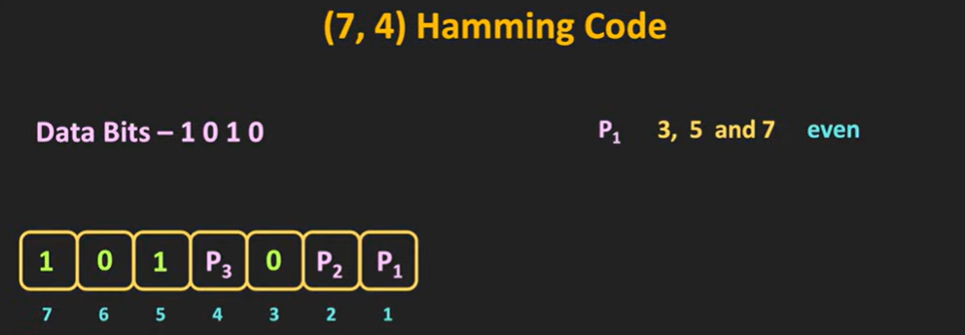

Slide 52
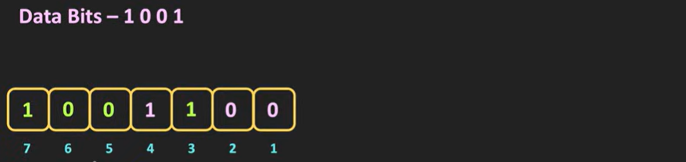
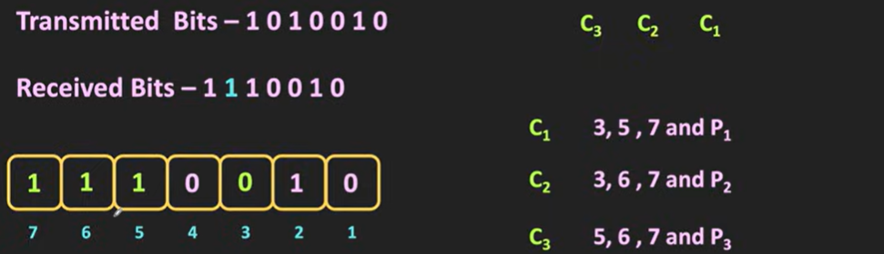

Slide 53
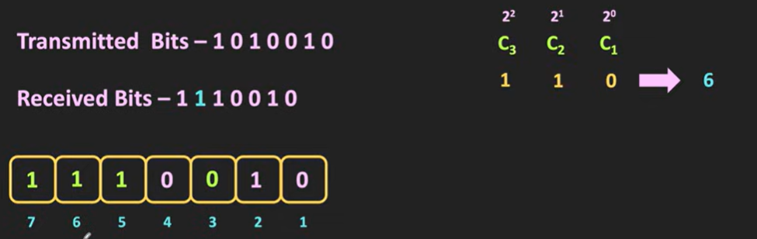

Slide 54
LECTURE #10:
Elementary Data Link protocols,
Stop and Wait

Slide 55
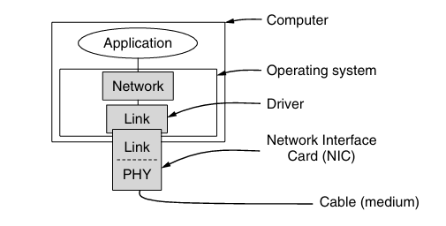
Elementary Data Link Protocols
Elementary Data Link Protocols illustrate how reliable communication can be achieved over a point-to-point link by gradually adding features such as flow control and error handling.
1. Utopian Simplex Protocol
Assumes an ideal, error-free channel
Sender transmits frames continuously
Receiver always ready to accept data
No flow control, no error control
Used only for theoretical understanding

Slide 56
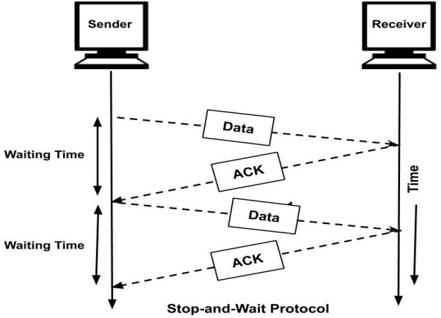
Simplex Stop-and-Wait Protocol (Error-Free Channel)
This protocol assumes a perfect communication channel where no frames are lost, damaged, or duplicated. Data transmission occurs in only one direction (simplex) from sender to receiver.
Working Principle
The sender transmits one data frame.
The sender stops and waits until it receives an acknowledgment (ACK) from the receiver.
After receiving the ACK, the sender sends the next frame.
This cycle continues until all frames are transmitted.

Slide 57
Key Characteristics
One frame in transit at a time
Receiver sends an ACK after receiving each frame
Sender cannot send a new frame until ACK is received
Flow Control Mechanism
The protocol ensures that the receiver is never overwhelmed
Since the sender waits for ACK, the receiver processes one frame at a time
Hence, flow control is achieved naturally
Limitations
No error handling (assumes error-free link)
Low efficiency:
Sender remains idle while waiting for ACK
Especially inefficient when propagation delay is large
Poor utilization of bandwidth on long-distance or high-speed links

Slide 58
Simplex Stop-and-Wait Protocol (Noisy Channel)
This protocol extends the previous one to operate over a noisy channel, where frames or acknowledgments may be lost or corrupted.
Additional Challenges Addressed
Frame loss
Frame corruption
Duplicate frame delivery

Slide 59
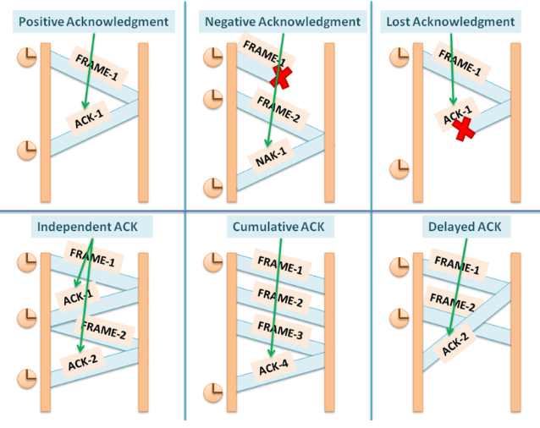
Types of Acknowledgement

Slide 60
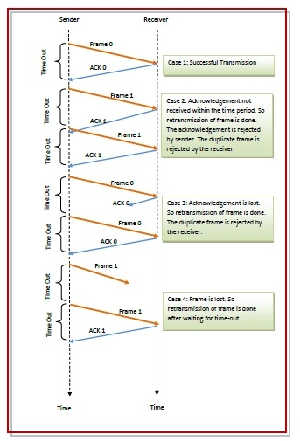

Slide 61
Working Principle
The sender sends one frame with a sequence number (0 or 1).
The sender starts a timer after transmission.
The receiver:
Accepts the frame if it is correct
Sends an ACK containing the same sequence number
If the sender:
Receives correct ACK → sends next frame
Does not receive ACK before timeout → retransmits the frame
Role of Sequence Numbers (0/1)
Prevents duplicate frame delivery
Helps receiver distinguish between:
A new frame
A retransmitted frame
Only 1-bit sequence number is sufficient because only one frame can be outstanding

Slide 62
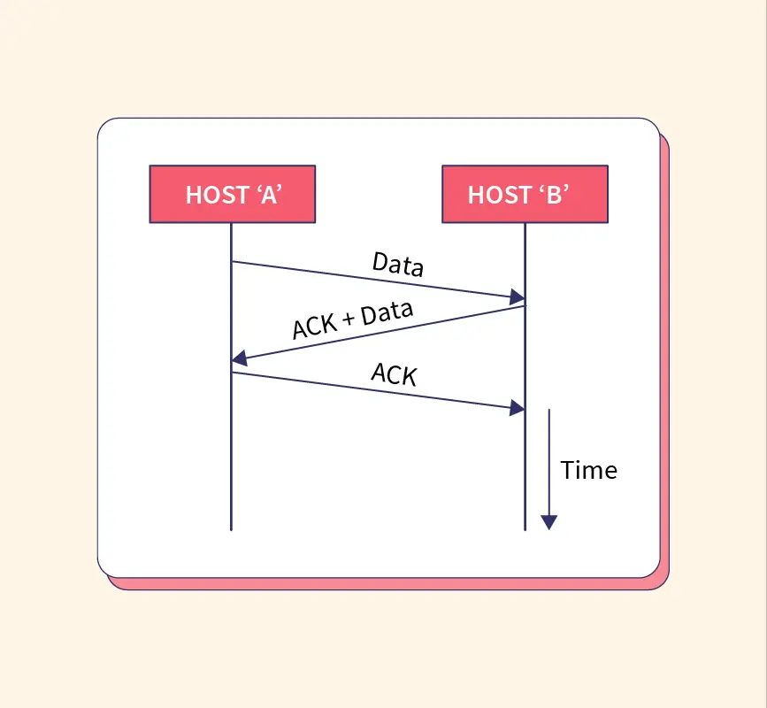
Piggybacking
The technique of temporarily delaying outgoing acknowledgements so that they can be hooked onto the next outgoing data frame is known as piggybacking.
Reduced Bandwidth Usage: Fewer packets are transmitted, which lowers overhead.
Improved Efficiency: Optimizes network resources by maximizing payload usage.
Lower Latency: Decreases the total number of frames in the network, improving speed for interactive applications.

Slide 63
Error Control Mechanisms
Error detection using checksum/CRC
Timeout-based retransmission
Duplicate detection using sequence numbers
Flow Control
Same as error-free version:
Only one frame in transit
Receiver controls sender rate via ACKs
Advantages
Works reliably over noisy links
Ensures correct and ordered delivery
Simple to implement
Limitations
Still inefficient for long-delay links
Poor channel utilization due to waiting
Forms the basis for more advanced protocols (sliding window)

Slide 64
LECTURE #11:
Sliding Window (Go Back N,
Selective Repeat)

Slide 65
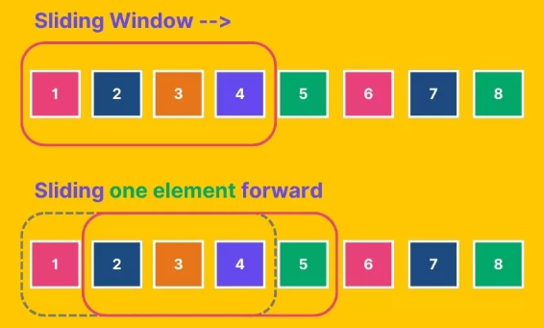
Sliding window
the sliding window is an abstract concept that defines the range of sequence numbers that is the concern of the sender and receiver

Slide 66
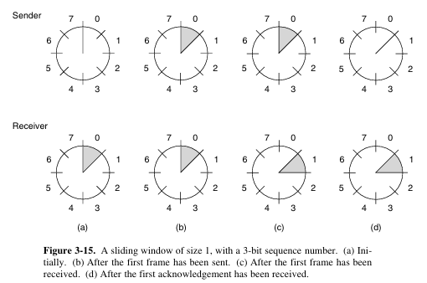

Slide 67
The Sliding Window Protocol is a flow control and error control method in computer networks, allowing a sender to transmit multiple data frames before receiving acknowledgments, improving efficiency over simpler protocols like Stop-and-Wait.
It uses an "imaginary window" of sequence numbers to manage outstanding packets, enabling reliable, ordered delivery, commonly used in TCP and Data Link Layer protocols

Slide 68
Terminology
Windows: The protocol defines a "sending window" (buffer of frames to send) and a "receiving window" (buffer for frames to accept).
Sequence Numbers: Each frame gets a sequence number, allowing the receiver to reorder packets and identify missing ones.
Sliding Action: Once a frame is acknowledged, the window "slides" forward to allow more frames to be sent, increasing throughput.

Slide 69
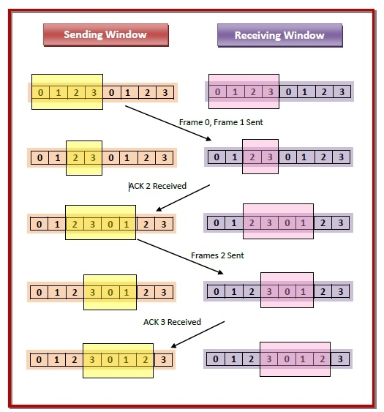

Slide 70
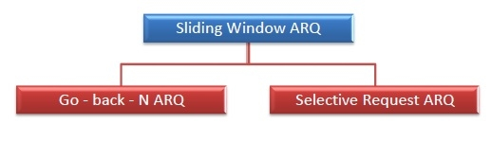
Types of Sliding Window Protocols
Go – Back – N ARQ
Go – Back – N ARQ provides for sending multiple frames before receiving the acknowledgment for the first frame. It uses the concept of sliding window, and so is also called sliding window protocol. The frames are sequentially numbered and a finite number of frames are sent. If the acknowledgment of a frame is not received within the time period, all frames starting from that frame are retransmitted.
Selective Repeat ARQ
This protocol also provides for sending multiple frames before receiving the acknowledgment for the first frame. However, here only the erroneous or lost frames are retransmitted, while the good frames are received and buffered.

Slide 71
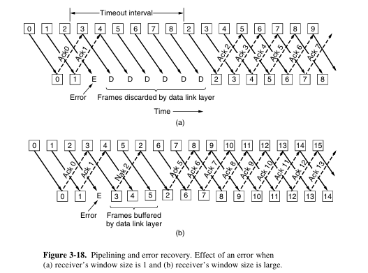

Slide 72
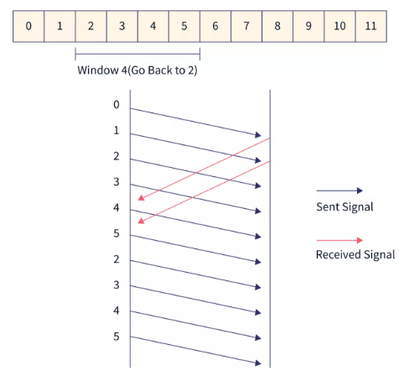
Sliding Window -Go Back N
The Go-Back-N (GBN) protocol is a sliding window–based data link (and transport) layer protocol designed to improve channel utilization compared to Stop-and-Wait, while still providing reliable and ordered data delivery over a noisy channel.
Instead of sending only one frame at a time, GBN allows the sender to transmit multiple frames without waiting for individual acknowledgments, up to a fixed window size N.

Slide 73
The receiver simply to discard all subsequent frames, sending no acknowledgements for the discarded frames.
This strategy corresponds to a receive window of size 1.
In other words, the data link layer refuses to accept any frame except the next one it must give to the network layer.
If the sender’s window fills up before the timer runs out, the pipeline will begin to empty.
Eventually, the sender will time out and retransmit all unacknowledged frames in order, starting with the damaged or lost one. This approach can waste a lot of bandwidth if the error rate is high.

Slide 74
Selective Repeat
The other general strategy for handling errors when frames are pipelined is called selective repeat. When it is used, a bad frame that is received is discarded, but any good frames received after it are accepted and buffered. When the sender times out, only the oldest unacknowledged frame is retransmitted.
If that frame arrives correctly, the receiver can deliver to the network layer, in sequence, all the frames it has buffered. Selective repeat corresponds to a receiver window larger than 1. This approach can require large amounts of data link layer memory if the window is large.
Selective repeat is often combined with having the receiver send a negative acknowledgement (NAK) when it detects an error, for example, when it receives a checksum error or a frame out of sequence. NAKs stimulate retransmission be fore the corresponding timer expires and thus improve performance.

Slide 75
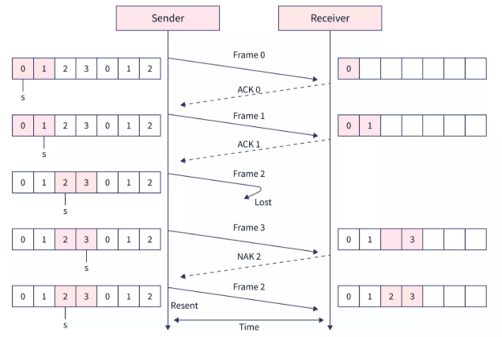

Slide 76
LECTURE #12:
Medium Access Control Sublayer Channel Allocation problem

Slide 77
Media Access Control
Multiple devices simultaneously attempt to access a communication channel on a network for communication purposes, but which devices will gain access to the channel is decided by the access control mechanism.
There will be no need to use access control if the channel has a dedicated path between devices for communication. But when communication over a communication channel does not have a dedicated path between devices, then access to the channel should be prioritized.
The media access control layer of the data link layer is responsible for access control.
Media access control ensures that there will be no conflict between communication devices on a channel.
Typically, access control is used when devices are connected and use a common link known as a multipoint link.

Slide 78
Medium Access Control Sublayer
In any broadcast network, the key issue is how to determine who gets to use the channel when there is competition for it.
Broadcast channels are sometimes referred to as multiaccess channels or random access channels.
The protocols used to determine who goes next on a multiaccess channel
belong to a sublayer of the data link layer called the MAC (Medium Access Control) sublayer.
The MAC sublayer is especially important in LANs, particularly wireless ones because wireless is naturally a broadcast channel. WANs, in contrast, use point-to-point links, except for satellite networks.

Slide 79
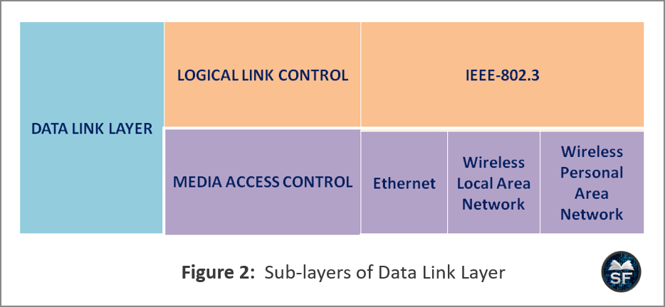

Slide 80
Logical Link Control (LLC):
The LLC of the data link layer communicates with the upper layer and the lower layer. On the upper layer, it communicates with the networking software, whereas in the lower layer, it communicates with the hardware of the device.
LLC receives packets from the network layer and stores the information in a frame using a protocol. The LLC also identifies which network layer protocol is used for the frame.
When the LLC receives packets from the network layer, it adds layer-2 (data link layer) control information to send packets from the sender to the receiver.

Slide 81
Media Access Control (MAC)
Basically, MAC is responsible for data encapsulation and access control.
The MAC sub-layer of the data link layer manages the NIC information, which is responsible for sending and receiving frames over guided or unguided media.
The MAC sub-layer provides delimiters that identify fields of the frame. It ensures whether the frame sent by the sender is correctly received by the receiver.
When MAC receives the packet, it starts the data encapsulation process. It adds the header and trailer to the packet and makes the frame. The trailer is used to detect transmission errors. After that, it provides the sender and receiver address to transmit the frame from sender to receiver.
The MAC layer allows multiple devices to communicate over a shared channel that operates on half-duplex, as full-duplex mode communication does not require an access control mechanism.

Slide 82
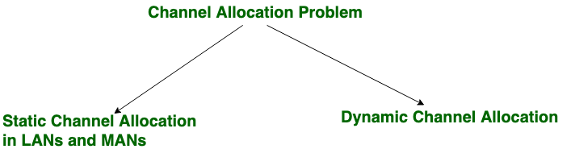
Channel Allocation Problem

Slide 83
Static Channel Allocation
This is a traditional way of allocating a single channel among multiple users. In static allocation, the channel’s bandwidth is split into equal-sized portions among users, and each user gets a portion of the bandwidth.
In static channel allocation, the network bandwidth is divided equally between devices and is permanent for devices.
For example, there are 50 users on the network, and the network bandwidth is 100 Hz. The 100 Hz bandwidth would be divided into 50 equally sized parts that are 2 Hz. Each user will get a 2 Hz portion.
Each device has a private frequency band, so there is no possibility of interference with other devices.
A well-known example of a single channel allocation scheme is FM radio, in which different frequencies are assigned to different stations that are fixed.

Slide 84
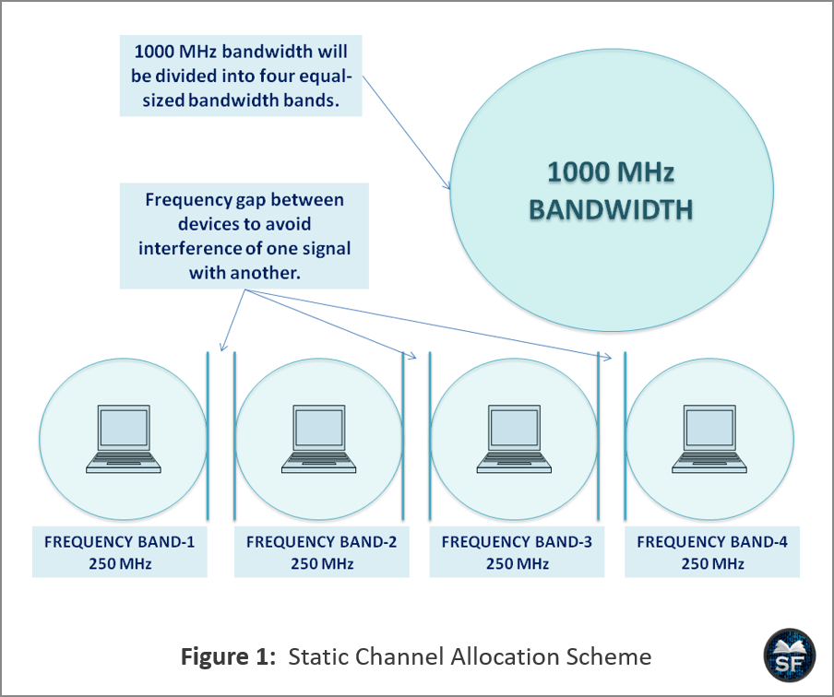

Slide 85
Disadvantages
Let’s say the bandwidth is divided for 50 devices, and only 40 devices are active on the network, then the bulk of the valuable bandwidth will be wasted.
If there are equal-sized portions of bandwidth for 50 devices and 60 devices want to communicate, 10 devices will be denied permission due to lack of bandwidth.
Now, let’s say 50 equally-sized bandwidth portions are assigned to 50 devices. But the problem is that when some devices are idle, their bandwidth will be lost simply because they are not using it, and no one is allowed to use it.
In a static allocation channel, most of the channels will be idle for most of the time.

Slide 86
Dynamic Channel Allocation
In dynamic channel allocation, the bandwidth is not allocated to the device permanently, the frequency band is allocated to the device whenever required.
When the device completes its communication on a channel, it is de-allocated, and the same channel can be assigned to another device.
In dynamic channel allocation, a channel is dynamically allocated between devices.

Slide 87
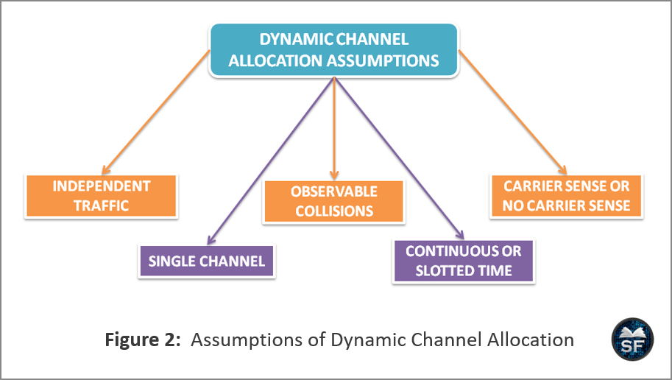

Slide 88
Independent Traffic: In this assumption, there are n independent devices controlled by the program or user that generate frames for transmission. The expected number of frames generated in the channel depends on the length of the interval and the rate of arrival of new frames.
After creating a frame, the device is blocked and does nothing until the frame is successfully transmitted over a channel.
Single Channel: There is a single channel between devices for communication, in which all devices can send and receive from it.
In single-channel assumption, protocols are used to prioritize frames from less important frames to more important frames.
The channel transmits frames from one device to another according to the priority of the frame.
Observable Collisions: The collision occurs when two frames are traveling on a shared channel and overlap with each other. When a collision occurs between frames, all devices can detect that a collision occurred on a channel. The lost frame can be retransmitted after some time. No error is produced here compared to that generated by the collision.

Slide 89
Continuous or Slotted Time: We can consider the time constant as when frame transmission can be initiated at any instant. Time can be slotted or divided into discrete intervals known as slots. When the slot is allocated to the device or channel, the frame transmission must start at the beginning of the slot.
For the idle slot, the slot has 0 frames for transmission. Similarly, successful transmission occurs if the slot contains one frame, and a channel collision will occur if the slot contains more frames.
Carrier Sense or No Carrier Sense: In the carrier sense, the device checks whether the channel is in use before using the channel. If the station finds the channel busy, it will not broadcast any frame on the channel. If there is no carrier sense, the station may not understand the channel before use, leading to frame collisions.

Slide 90
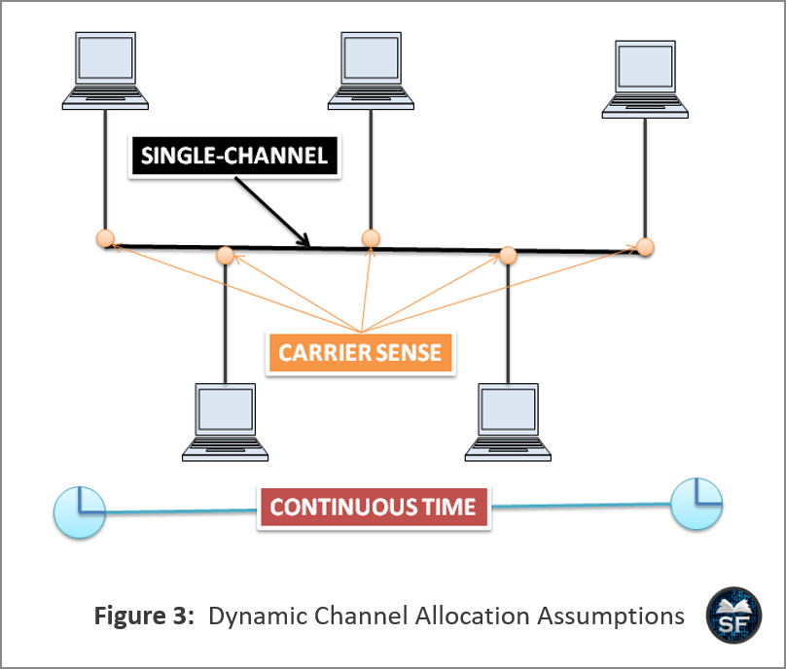

Slide 91
LECTURE #13:
Multiple access Protocol
(Aloha, Carrier Sense Multiple Access (CSMA/CD)

Slide 92
Random Access
In random access, no device is superior to any other device connected to a channel, and no device has control over the other device. Any device can transmit whenever it wants, so the transmission between devices is random. Hence, these methods are known as random access.
In random access, no device permits another device to send frames on a channel.
At any time, the device uses the protocol when it wants to send a frame. Depending on the protocol, the device will decide whether to send or not.
Here, there is no scheduled time for a device to transmit the frame. Transmission occurs randomly over a channel between devices.
In random access, there is no rule as to which device is next to send the frame. So the devices compete with each other to access the channel to transmit the frame.
Frames will either be lost or modified if more than one device sends over a shared channel. So devices use a protocol to overcome this problem
The two random access protocols are as follows:
ALOHA
CSMA

Slide 93
ALOHA
ALOHA is a random access method used in wireless LANs and on any shared media. In ALOHA, media is shared between devices.
It may be possible that when a device sends data over a channel, another station may attempt to send the data at the same time.
When multiple devices try to send data over the same channel, they collide, and the data gets distorted.
ALOHA includes a simple and elegant way to solve the problem of channel allocation.
ALOHA is applicable for systems in which uncoordinated devices are competing for access to a shared channel.
There are two types of Aloha methods as follows:
Pure ALOHA
Slotted ALOHA

Slide 94
The idea of the ALOHA system is simple that devices can transmit data whenever they have data to send. When more than one device sends data at the same time, a collision occurs between the frames. Therefore, the sender has to detect this problem when it is on the channel.
The device can listen for collisions when transmitting in some systems, such as a wired LAN.
If the frame is lost or destroyed, the sender waits for a random amount of time and resends it. Here, the wait time is random.
A system in which multiple devices share a channel has conflict is known as a contention system.

Slide 95

Pure ALOHA

Slide 96
Pure Aloha, when a receiver device successfully receives a frame, it sends an acknowledgment to the sending device.
If the acknowledgment is not received after the time-out period, the sender assumes that the frame has been destroyed and resends the frame.
After the timeout, collisions between frames occur when all devices resend the lost frame at once. To avoid collisions, each device waits a random amount of time before resending its frame.
Random timing helps to avoid more collisions known as back-off time Tb.

Slide 97
Slotted ALOHA
In slotted ALOHA, time is divided into Tfr slots, so the device can only send at the beginning of the time slot.
The device is only allowed to send at the beginning of the synchronized time slot. If it misses, it will have to wait until the start of the next time slot.
If two devices try to send at the beginning of the same time slot, the possibility of a collision between the devices still exists.

Slide 98


Slide 99
As shown in the figure, four devices shared a channel. Each device is sending two frames on a single channel.
Here the collisions are less as compared to pure ALOHA because they send the frame only when the particular time slot starts.
Out of 8 frames, 4 frames (Frame-1.1, Frame-2.1, Frame-4.1, and Frame-3.2) were successfully transmitted, and other frames were lost during transmission.
Slotted ALOHA vulnerable time is half that of pure ALOHA.

Slide 100
Carrier Sense Multiple Access (CSMA)
CSMA is developed to enhance the performance of the network by reducing the possibility of collisions. In CSMA, the device senses the channel before trying to use it to reduce the possibility of a collision. In Carrier sense protocol, devices listen to a carrier or transmission and act accordingly.
CSMA uses the “sense before transmit” or “listen before talk” principle, allowing the device to sense the channel before using it.
CSMA minimizes the possibility of collisions but does not provide any guarantee to eliminate it because the propagation delay for sending frames from one device to another may cause collisions on a channel.
When a device sends a frame, it takes very little time for the first bit to reach each device and each device to understand it. Simply put, a device can sense the channel and find it idle because the first bit sent by another device has not yet been received.

Slide 101


Slide 102
As shown in the figure, station B sends the frame at time t1, as it senses the channel and finds it idle.
Station-C senses the channel at time t2 and finds it idle because still, it has not received the first bit of Station-B, sent by Station-B on the channel. Now, both the signals will collide on a channel, and the frame destroyed.
Here the time required for the propagation of the signal from one end of the channel to the other is known as a propagation or vulnerable time TP.
A collision occurs when two devices send a frame at the same time. But if the first bit of the frame reaches the end of the channel, each station receives the first bit of the sending station, so they will not start broadcasting the frame until the station, transmitting the frame, has completed the transmission.

Slide 103
Persistence Methods
1-Persistent method
Non-Persistent method
P-Persistent method

Slide 104

1-Persistent Method
This method is simple and straightforward. In 1-persistent, when the device finds the channel idle, without waiting, it immediately sends its frame with probability 1.
In this method, frames are more likely to collide, as more than two devices can find the channel idle and send their frames immediately and simultaneously.

Slide 105

Non-Persistent Method
In this method, a station senses the channel and immediately sends the frame if it finds the channel idle. But if the channel is not idle, it waits for a random amount of time and then starts sensing the channel again.
The non-persistence approach minimizes the possibility of a collision because it is rare that two devices will wait and re-transmit the frame simultaneously.
This method affects the efficiency of the network as there may be stations to send frames when the channel is idle.

Slide 106
P-Persistent Method
In the p-persistent method, the channel has allocated a time slot for the transmission of frames, and the time slot has a slot duration in which the transmission has to complete. Here, the slot duration can be greater than or equal to the maximum propagation delay.
P-persistent improves efficiency and combines the strategies of the above two methods.
The station sends a frame with probability p. The station waits for the next time slot to start and senses the channel again with probability q = 1-p. If it finds the channel idle, it sends the frame. Otherwise, it acts as if a collision has occurred and uses the back-off procedure.

Slide 107

The station senses the channel continuously. When the station finds the channel idle, it checks the probability result.
If the probability result is greater than the probability p, it waits for a slot and senses the channel again. If it finds the channel busy, it uses the back-off procedure, though a collision occurred. Otherwise, it checks the probability result.
If the probability result is less than or equal to p, the station will send the frame.

Slide 108
CSMA with Collision Detection Protocol (CSMA/CD)
CSMA/CD enhances the algorithm to handle collisions during transmission. Detects whether there is a collision on a channel or not. In this method, a device monitors the channel after sending the frame to see if the transmission was successful. The channel shall notify the station in case of collision during transmission.
CSMA/CD uses persistence methods to understand the channel. Transmission and collision detection is a continuous process in CSMA/CD.
In CSMA/CD, the station transmits and receives frames continuously and simultaneously.
The station continuously monitors the channel to see if a broadcast has ended or a collision is detected on a channel. If the collision is not detected, it means that the transmission is complete.
The maximum throughput of CSMA/CD depends on the value of G and the persistence methods. Its throughput value is higher than that of Aloha’s two protocols.
For the 1-persistent and non-persistent methods, the maximum throughput is approximately 50% (G=1) and 90% (between G=3 and 8), respectively.

Slide 109


